Slide 1
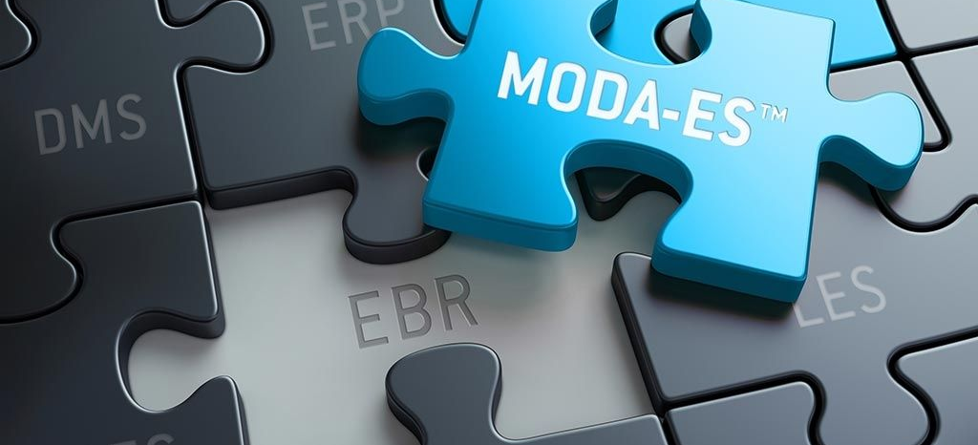

MODATM Platform
Paperless Product release solution for Cell and Gene Therapy

Slide 2

What is the MODA™ platform
More science. Less paper TM
The MODA™ Platform is built around innovation, flexibility and speed. Freeing up time to allow our customers to deliver the medicines of tomorrow, today.
MODA™ helps gain complete insight into your manufacturing and QC operations.
MODA™ reduces the data integrity and compliance risks while improving business processes

Slide 3
Paperless execution for manufacturing and QC
MODA-EM
MODA-ES
The MODA™ System is the only one on the market designed and built to manage QC Microbiology.
Implemented by >70 Companies globally with multiple Global roll outs for major pharma
QC Micro Testing: Environmental Monitoring, Sterility, Product Endotoxin, Product Bioburden, Growth Promotion, Gowning Qualification
Comprehensive trending and reporting, access to data for investigations
Data Integrity compliance
Integration to devices and systems
Built for CGT processes designed by the end user
Review by exception – expedited release
Minimize GMP risk - reduces human error, maximize utilization
Manages scale up clinical – commercial
Access to data for trending, dashboards
Traceability
Single source of data – integration for automated data capture

Slide 4
More Science. Less Paper.TM
MODA-ESTM Platform
Next Generation Electronic Batch Record & Release platform
An affordable solution to batch record challenges
Flexibility to work from clinical through commercial
Manufacturing
Quality
MODA-EMTM Solution
Designed and built to manage QC Microbiology processes
Enforce compliance to Data Integrity requirements
Interfaces to devices and systems
40+ pre-validated, out-of-box reports to support trending and expedite investigations
The
MODATM Platform
MODATM eLogs
Introducing the eLogs module to replace your paper logs with easy-to-use electronic logs.
Easily schedule and execute logs with our user-centric interface
Logs
Notes:
Overview of the platform

Slide 5
Established commercial software solution for paperless QC microbiology
>70 Companies globally are using MODA leverage the expertise and best practices of this user community
>4,000 Users globally
Providing feedback on meeting the end user needs and making their workload easier
>120 Industrial sites with many customers using MODA as their global solution, including Lonza. Optimized implementation and validation approach to meet aggressive project timelines

Slide 6

Lonza global strategy to digitize quality and manufacturing
Slough (UK)
Clinical development and manufacturing
Licensing
Porriño (Spain)
Mammalian manufacturing
Walkersville
Verviers, BE
Portsmouth, NH (USA) Mammalian manufacturing
Cell and gene therapy
Hayward
Slough, UK
Geleen NL
Visp (Switzerland)
Clinical development and manufacturing Microbial and mammalian manufacturing
API manufacturing
Guangzhou, CN
Hayward, CA (USA) Clinical development and manufacturing
Portsmouth
Porriño, SP
Stein CH
Verviers (Belgium) Bioscience solutions
Houston
Visp, CH
Pearland, TX (USA) Cell and Gene Therapy
Singapore
Geleen (Netherlands) Cell and Gene Therapy
Walkersville, MD (USA) BioScience Solutions
Tuas (Singapore) Clinical development and manufacturing
Mammalian manufacturing
Cell and gene therapy
Stein (Switzerland)
Clinical development and manufacturing
Fill-Finish
Guangzhou (China)
Mammalian development and manufacturing services
Notes:
Lonza strategy to digitize quality and manufacturing

Slide 7
Purpose built for QC microbiology
Extensive test method library
Environmental
Utilities
Personnel
Viable
Non-Viable
Surface
Settling Plates
Swabs
Bioburden
Endotoxin
TOC
Conductivity
pH
Heavy Metals
Nitrates
QC Micro
Product
Gas Sampling and Testing
Organism ID
Growth Promotion
Gowning Qualifications
Media Fills
Product Bioburden
Endotoxin
Sterility
Clean Compressed Air
Nitrogen
Oxygen
Oil
Moisture

Slide 8
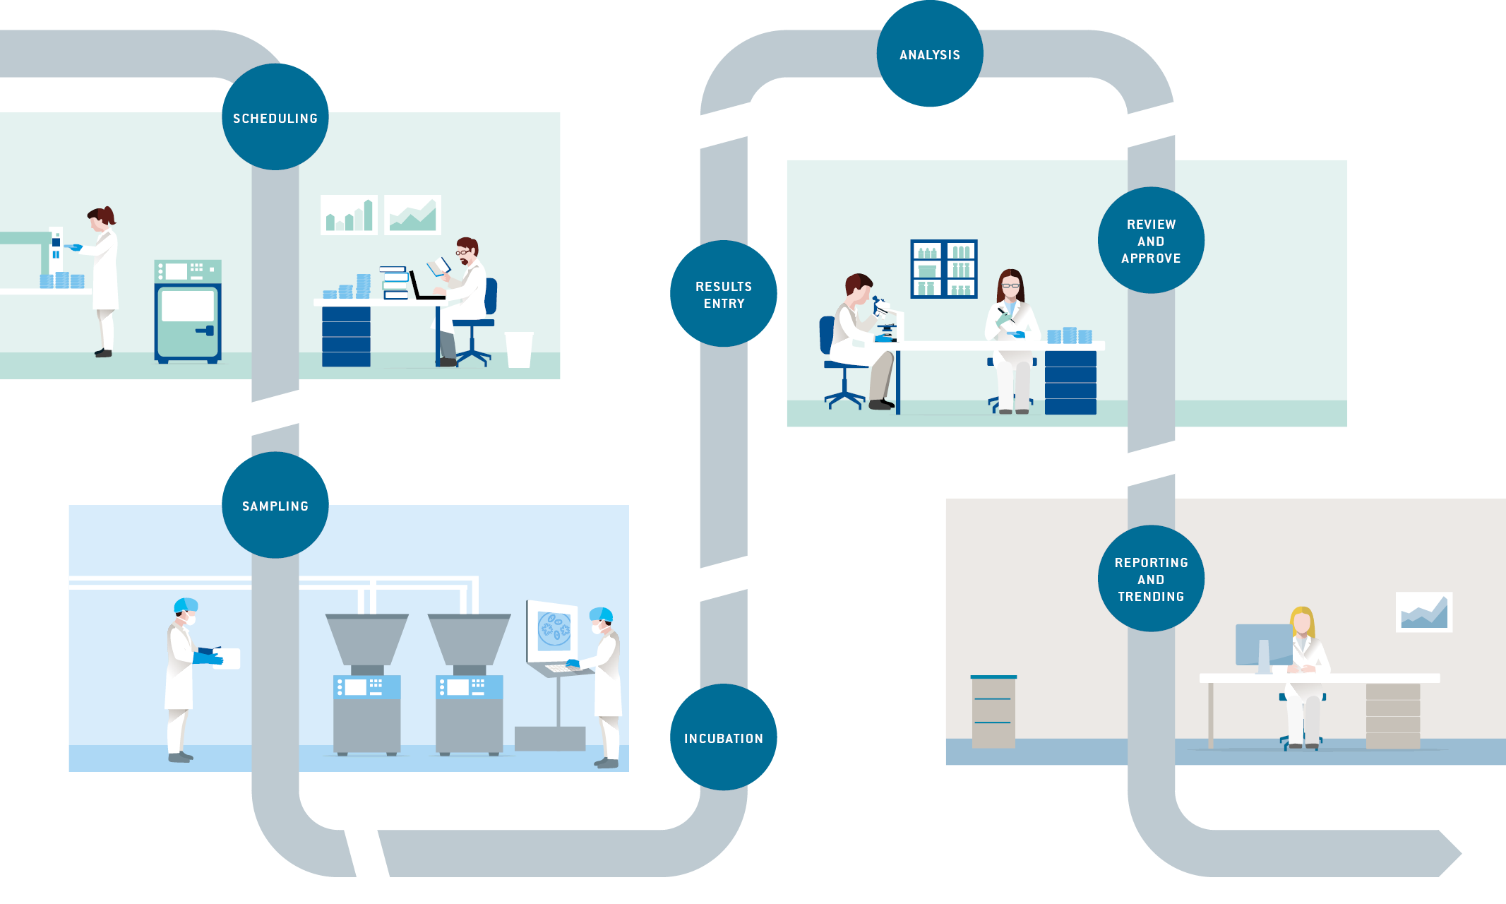

Batch process
Paperwork Creates a Broken, Dis-jointed Process
ANALYSIS
TESTING
PRODUCTION
BATCH
RECORD
STORAGE
MANAGE
SAMPLES
REPORTING &
TRENDING
Notes:
Bring in Icons per section

Slide 9
Why MODA for CGT
Brings the lab and manufacturing data together- one record, one platform, expedited release
Lonza built the system specifically for Cell Therapy
Total Solution
Technical Expertise
Modular design
End user interface emphasized due to manual processing
Need for Flexibility to adapt processes as technology changes
Updating the batch record by technical writers and process leads, Not Coders
Built around traceability of patient material in manufacturing and QC
Handles the testing of Cell Therapy products
Manufacturing and QC
Complete paperless execution
Lonza’s Cell Therapy Expertise combined with MODA’s commercial software platform
Experienced Cell Therapy technicians were part of the design process
Ensured that process technical personnel could work easily with the system
Designed for the needs of CMO business which included multiple Cell Therapy techniques and technologies
Allows for use of common processes (Line Clearance, Room Release) to be validated independently and re-used for other products/processes
Limited validation effort, configuration over customization
Modules built specifically for Cell Therapy Track and Trace of patient material and Equipment Availability/Scheduling to reduce risk of cross-contaimination

Slide 10
User interface
Ease of use for end user makes transition from paper easier
Instructional Text
Add instructional text and videos to guide the technicians through the process
Instruction text can be at individual field level or section level
Review and Approve by exception
MODA-ESTM creates a review/approve checklist similar but better than the paper checklist
An exception count for each process is provided to show reviewers what they need to review.
Measurements
Easily capture numeric, string, date/time, equipment, materials and more
Validated processes that perform all calculations means no calculating during review
Data Integrity is built directly in review and approve.
The history tab shows the previous value, the new value, who made the change and what date/time the change was made all without leaving the review and approve screen
Integration to ERP ensure correct material part/lot numbers are used and blocked or expired materials are not used.
Electronic Signatures
9 different electronic signature configurations
Ability to queue signatures for a performer in a BSC or Isolator to sign when critical processes are completed
Each process can be signed off as it is completed
When final test is complete, sign off and release the batch
Workflow
Driven by the System
User viewable to see where the technician is in the process

Slide 11

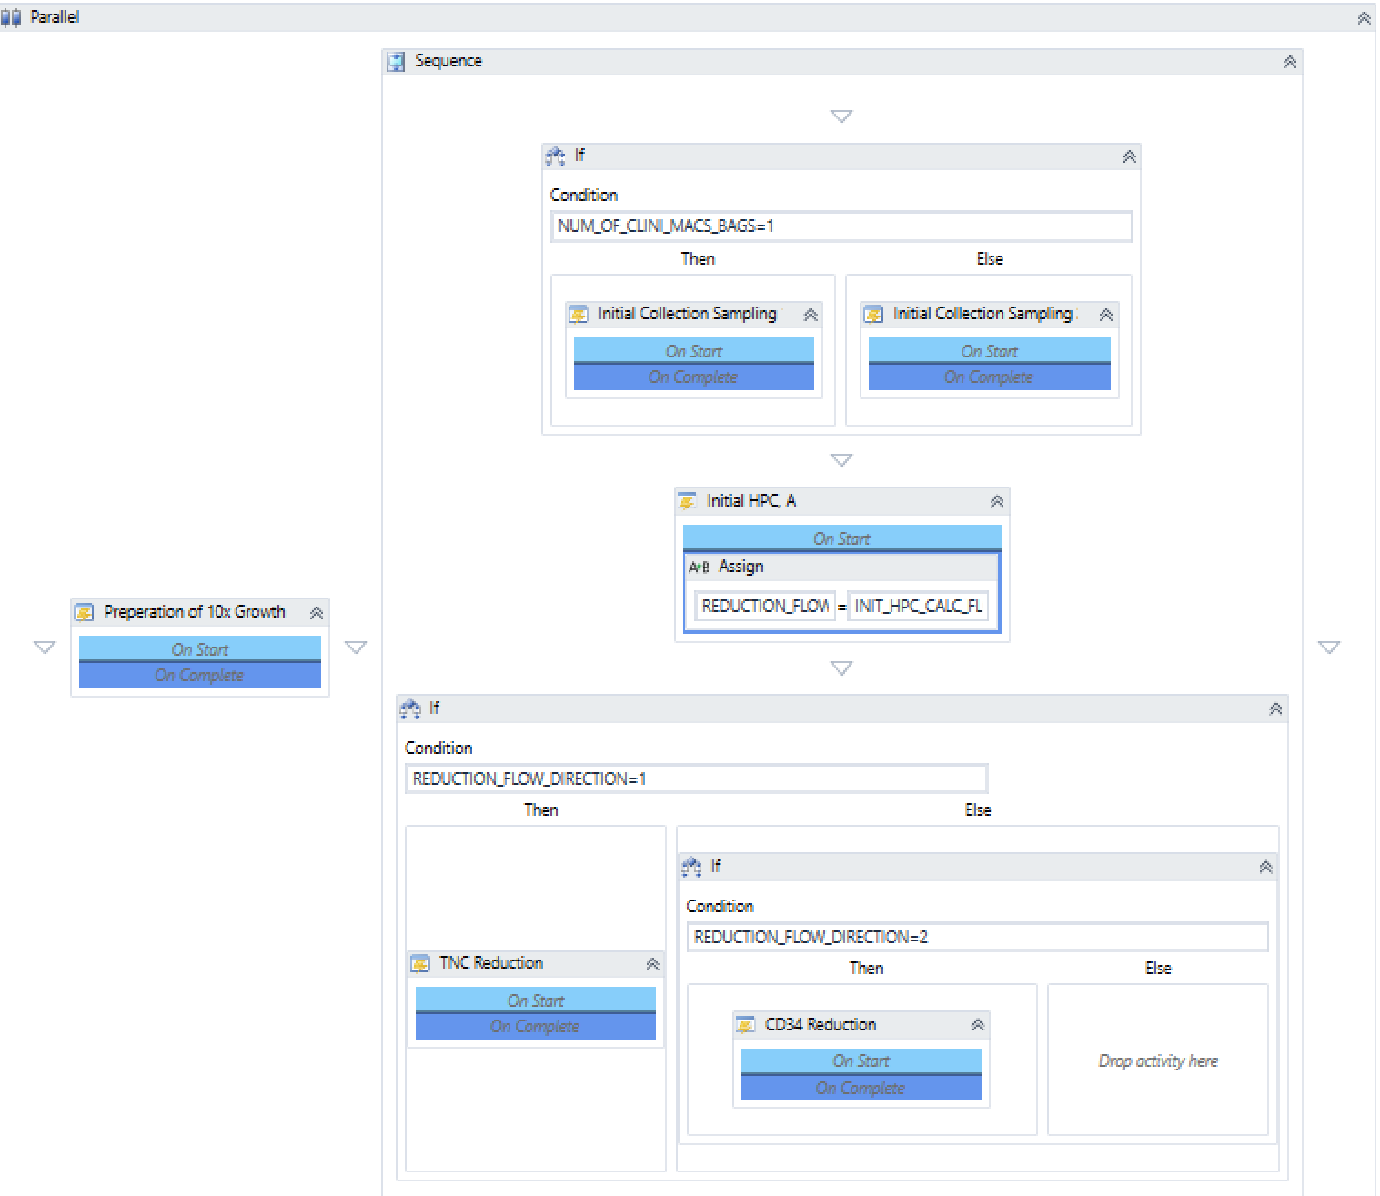
Configurability over customization
Simplified user interface for configuration
Easy configuration
Configuration built for people who know the process, not for people who can code
Configuration through drop-downs and add buttons
Flexible
Quick and easy to change instructional text or capture additional information for CAPA’s
Flexible to make process modifications as customers move through clinical/commercial phases and technology changes
Powerful
Integration tool box allows for integrations to equipment, automation layers and enterprise systems
Workflow
Drag and Drop Workflow for parallel vs sequential processes
Validates system makes process branching decisions instead of technicians

Slide 12
Process development
Configuration model reduces cost and time to go-live
Qualified Processes
Batch Attributes
Product A Library Values
Patient Material
Patient Material
Product B Library Values
Room Release
Room Release
Room Release
Once qualified processes are in place they can be dropped into workflow to create a product process to cover the entire manufacturing process
Re-use qualified processes without revalidation`
Data can be passed from one process to another. The technician no longer has to look back in the batch record for previous information.
Data can be aggregated to final process such as lot reconciliation and yield to perform final calculations without technician input.
Library Values are associated with each product and define specifications (i.e. Limits and parameters) that are unique to the product.
Library values are read into the process and used to make decisions to drive workflow and calculations.
Using the product library multiple products can be associated with the same Product Process.
Material Transfer
Material Transfer
Material Xfer
Line Clearance
Line Clearance
Line Clearance
Line Clearance
Line Clearance
Line Clearance
Line Clearance
Activation
Activation
Transduction
Transduction
Final Formulation
Expansion
Expansion

Slide 13
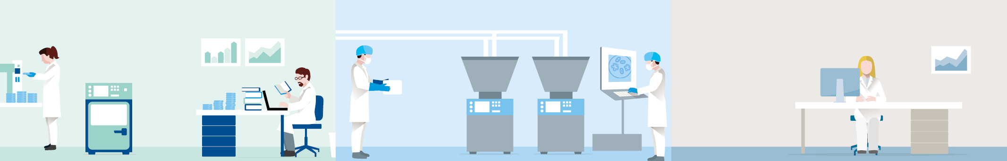
Integration
Toolbox to integrate from devices to enterprise systems
LIMS
ERP
QMS
Calibration
Management
Scales
Auto-mation Layer
LES
MiniTabTM
Integration Toolbox allows for efficient and powerful integrations to:
Reduces Operator Error Opportunities
Strengthens Data Integrity

Slide 14

Cost
`
Configuration lessens the validation burden which is the largest internal resource cost of projects.
`
Modular design allows for re-use of processes which removes costly rework.
`
Ease of configuration allows for customer to make changes they need over time without paying high consulting fees
Configuration lowers cost of upfront and total cost of ownership
`
Lower Total Cost of Ownership (TCO). Lack of customization means customers can upgrade to the newest, most compliant version without verifying all customizations will work.
`
Strong return on investment due to lower upfront costs and excellent efficiency gains.

Slide 15
Tangible benefits
Efficiency
Quality
Cost
Expedited review and approve by exception
Integration with systems and equipment to speed up data entry
Visual, predictive analytics for continuous improvement
Elimination of handwritten, calculation and workflow errors
Prevent most common deviations and intervene when they do occur
Demonstrable chain of custody and built-in data integrity
Reduction in QA & Manufacturing review time by 50-70%
20% reduction in production hours batch recording and review time
Lower Total Cost of Ownership: One platform, One record, Expedited release- available anywhere

Slide 16
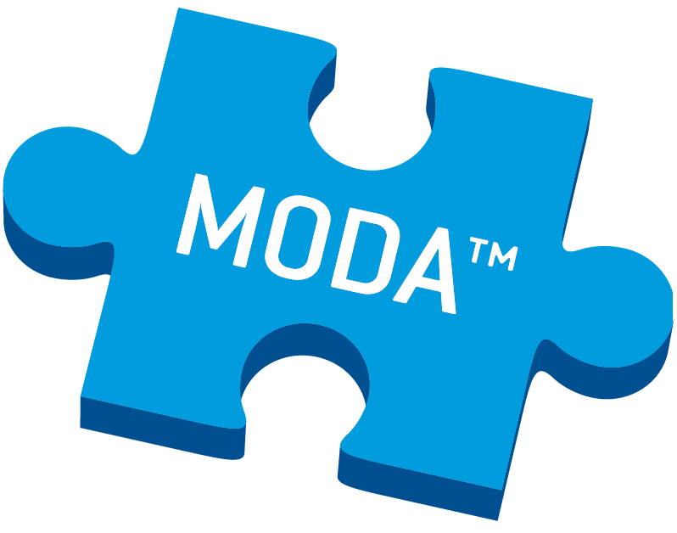
All trademarks belong to Lonza or its affiliates or to their respective third party owners.
The information contained herein is believed to be correct and corresponds to the latest state of scientific and technical knowledge. However, no warranty is made, either expressed or implied, regarding its accuracy or the results to be obtained from the use of such information and no warranty is expressed or implied concerning the use of these products.

